Slide 1


S4D400 - Introduction to abap programming on s/4hana
Anubhav Oberoy

Slide 2

INTRODUCTION

Slide 3

Agenda – Day 1
The Development Model in SAP S/4HANA
- R/3 System Architecture
- What is SAP HANA
- Introduction to SAP S/4HANA
- Understanding Dispatcher and Work process
- What is client in SAP System?
- Development Tools - SAPGUI, ADT
- Connecting to system and checking system information
---Break---
ABAP Dictionary
- Introduction to Data Dictionary
- Creating Data Elements, Domains and Structures
- Creating Database tables
- Currency and Unit Conversion
- Table Maintenance and Technical settings
- Size Category and Data class
- Introduction to EPM Data Model

Slide 4

What is an ERP system?
Enterprise Resource Planning systems (ERPs) integrate (or attempt to integrate) all data and processes of an organization into a unified system. A typical ERP system will use multiple components of computer software and hardware to achieve the integration. A key ingredient of most ERP systems is the use of a unified database to store data for the various system modules.
The standard set of applications delivered with each R/3 system are the following:
PP (Production Planning)
MM (Materials Management)
SD (Sales and Distribution)
FI (Financial Accounting)
CO (Controlling)
AM (Fixed Assets Management)
PS (Project System)
WF (Workflow)
IS (Industry Solutions)
HR (Human Resources)
PM (Plant Maintenance)
QM (Quality Management)

Slide 5

2 Tier System
User Interface
Fat Client
Costly
Fast
Option 1: Application Logic
thin Client
Less Costly
Over-Loaded
Database
Option 2: Application Logic
Data

Slide 6
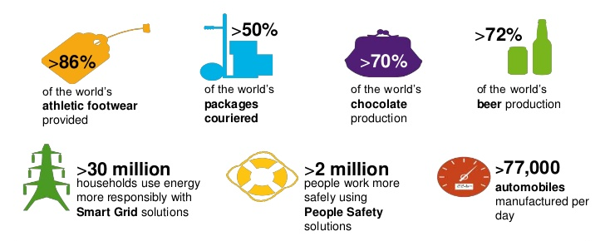
SAP at a Glance
SAP is known worldwide for its unique innovations that help the customers run their business with high efficiency. Some of its facts and figures stand as follows −
More than 263,000 customers in 188 countries.
More than 68,800 employees in more than 130 countries.

Slide 7



Introducing 3-tier
User Interface
Presentation Layer
SAP System
Application Layer
Database
Layer
Notes:
The sole purpose of an R/3 system is to provide a suite of tightly integrated, large-scale business applications. R/3 comes prepackaged with the core business applications needed by most large corporations. These applications coexist in one homogenous environment. They are designed from the ground up to run using a single database and one (very large) set of tables.
Presentation: It is usually installed on a user's workstation. When started, the presentation server displays the R/3 menus within a window. This window is commonly known as the SAPGUI, or the user interface (or simply, the interface).
Basis : Basis is like an operating system for R/3. It sits between the ABAP/4 code and the computer's operating system. SAP likes to call it middleware because it sits in the middle, between ABAP/4 and the operating system. ABAP/4 cannot run directly on an operating system. It requires a set of programs (collectively called Basis) to load, interpret, and buffer its input and output. Basis provides the runtime environment for ABAP/4 programs.
Database: The database server is a set of executables that accept database requests from the application server. These requests are passed on to the RDBMS (Relation Database Management System). The RDBMS sends the data back to the database server, which then passes the information back to the application server. The application server in turn passes that information to your ABAP/4 program.

Slide 8
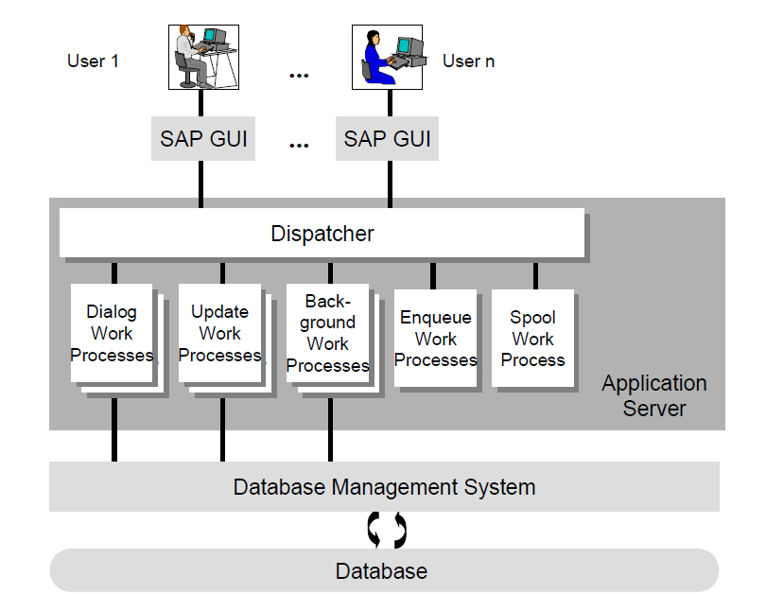
Inside of Application Server

Slide 9
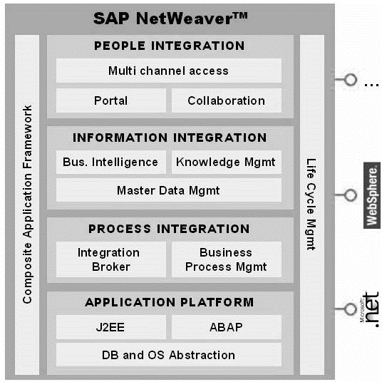
SAP Netweaver
SAP Basis is now called SAP Netweaver Application server. SAP basis is part of netweaver. If you consider netweaver as an apple(fruit), SAP basis is the core part. SAP netweaver is the technology and Integration platform of SAP solutions.

Slide 10
Types of Work-processes
There are seven types of work processes. Each handles a specific type of request. The type of work processes and the types of requests that they handle are shown in Table below
Type | Purpose
D (Dialog) | Dialog requests
V (Update) | Requests to update data in the database
B (Background) | Background jobs
S (Spool) | Print spool requests
E (Enqueue) | Logical lock requests
M (Message) | Routes messages between application servers within an R/3 system
G (Gateway) | Funnels messages into and out of the R/3 system

Slide 11

Understanding the Logon Client
The term logon client has nothing to do with Client/Server-it is completely different. The logon client refers to a business entity. It provides separation of data at entity level.
Jim
works at Business Unit 1 in USA
Jane
works at Business Unit 2 in USA
Data

Slide 12
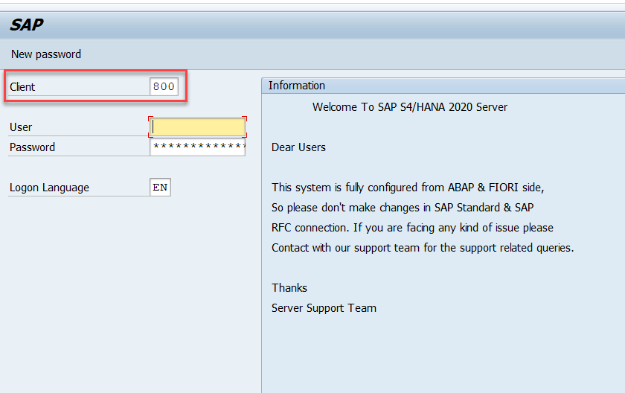
Exercise – Logon Screen
Open SAPGUI and connect to SAP Application Server. Check the logon screen with client field.

Slide 13
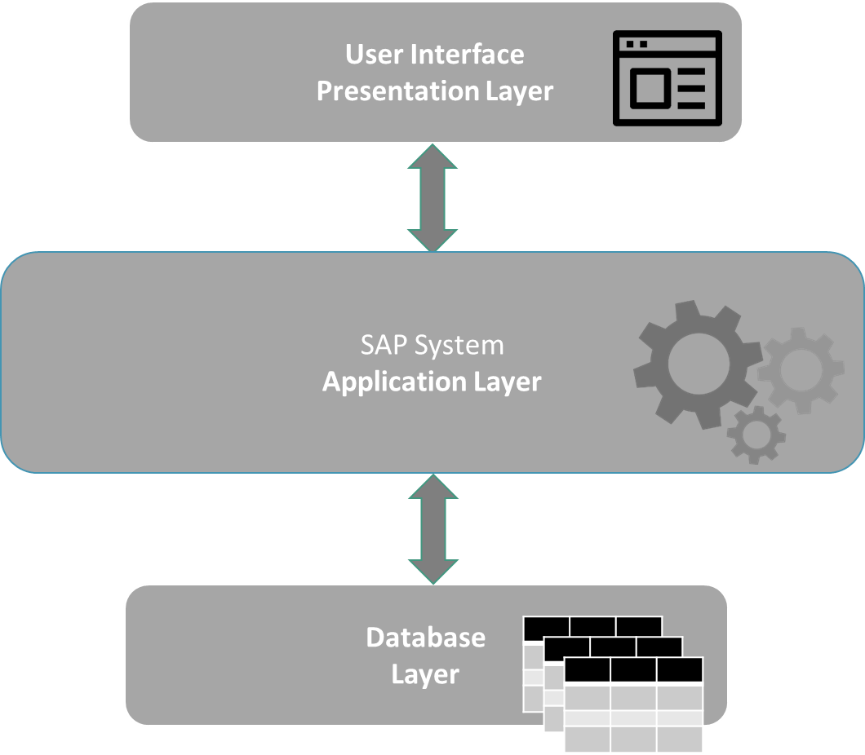

System Landscape
Development
Quality/Test
Production
Developers
Tester
End Users

Slide 14
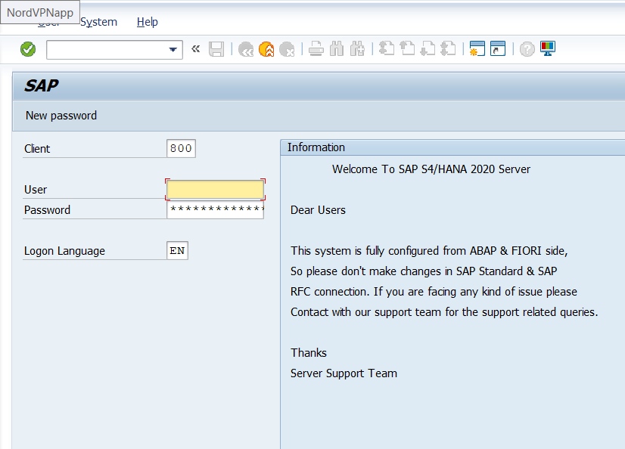
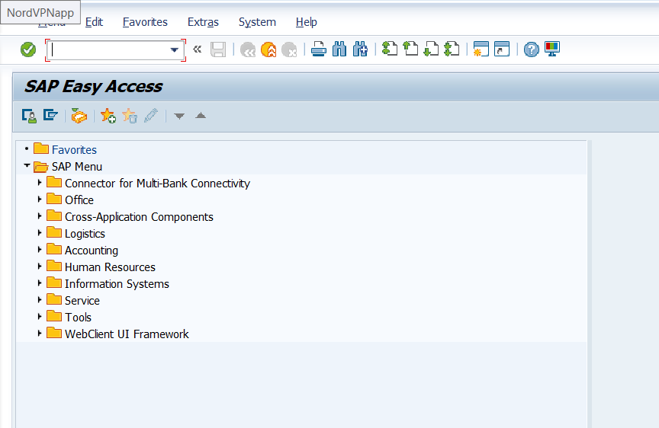
Exercise - Lets Connect!

Slide 15
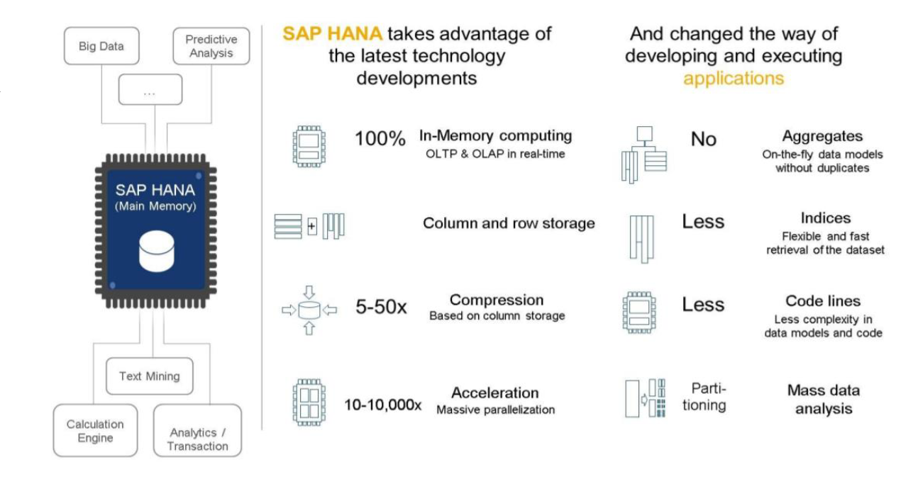
What is SAP HANA

Slide 16
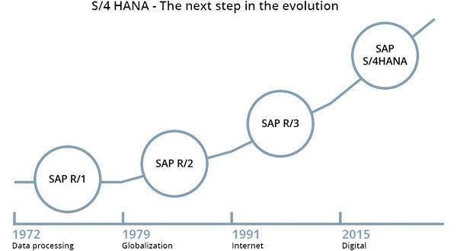
Introduction to S/4HANA

Slide 17
S/4HANA Benefits over Suite
Web-based access of most of business applications – Fiori UX
Built-in Intelligence with Machine Learning
Simplified Data models which reduce significant footprint of Data Storage
Complete Implementation based on Best-Practices
Leverage full potential of HANA Database in-memory
In-built Analytic Support
Available in two flavors – Cloud and On-premise

Slide 18
Release Cycles of S/4HANA
S/4HANA On-premise is a Yearly Release with 4 Support packs per Quarter
YEAR+MONTH – 1609, 1709, 1809, 1909, 2009
Release n-1
1909
Release n
2009

Slide 19

Exercise - How to check
Check HANA and S/4HANA system

Slide 20
Some T-Codes
SE01 – SAP Transport Manager CTS++
SM04 – User Sessions
SM50 – Work processes
SE11 – Data Dictionary
SE38 – ABAP Editor
SE24 – Class Builder
SE80 – ABAP Workbench
SE37 – Function Builder
ST22 – Runtime Errors

Slide 21
Basis TCodes
User Maintenance
SU01 User Maintenance
SU01D User Display
SU02 Maintain Authorization Profiles
SU03 Maintain Authorizations
SU05 Maintain Internet users
SU10 User Mass Maintenance
SMLG Maintain Logon Group
SUPC Profiles for activity groups
SUIM Info system Authorizations
PFCG Profile Generator
PFUD User Master Data Reconciliation
Client Administration:
SCC3 Checking Client Copy Log
SCC4 Client Administration
SCC5 Client Delete
SCC7 Client Import Post-Processing
SCC8 Client Export
SCCL Local Client Copy
SCC9 Remote client copy
Database Administration:
DB01 Analyze exclusive lock waits
DB02 Analyze tables and indexes
DB12 DB Backup Monitor
DB13 DBA Planning Calendar
DB15 Data Archiving: Database Tables
Transport Management System:
STMS Transport Management System
SE01 Transport and Correction System
SE06 Set Up Workbench Organizer
SE07 CTS Status Display
SE09 Workbench Organizer
SE10 Customizing Organizer
SE11 ABAP/4 Dictionary Maintenance
SE16 Data Browser
SE80 Repository Browser
SM30 Call View Maintenance
SM31 Table Maintenance
Background Jobs Administration:
SM36 Define Background Job
SM37 Background Job Overview
SM39 Job Analysis

Slide 22
Basis TCodes
Spool Administration:
SP01 Output Controller
SP11 TemSe directory
SP12 TemSe Administration
SPAD Spool Administration
Other Administration Tcodes:
AL11 Display SAP Directories
BD54 Maintain Logical Systems
OSS1 Logon to Online Service System
SALE IMG Application Link Enabling
SARA Archive Management
SICK Installation Check
SM14 Update Program Administration
SM35 Batch Input Monitoring
SM56 Number Range Buffer
SM58 Asynchronous RFC Error Log
Daily monitoring TCodes:
AL08 Current Active Users
SM12 Display and Delete Locks
SM13 Display Update Records
SM21 System Log
SM50 Work Process Overview
SM51 List of SAP Servers
SM66 System Wide Work Process Overview
ST22 ABAP/4 Runtime Error Analysis
ST01 System Trace
ST02 Setups/Tune Buffers
ST04 Select DB activities
ST05 Performance trace
ST06 Operating System Monitor
ST10 Table call statistics
ST03 Performance, SAP Statistics, Workload
SU56 Analyze User Buffer
Alert Monitoring T-codes
AL01 SAP Alert Monitor
AL02 Database alert monitor
AL04 Monitor call distribution
AL05 Monitor current workload
AL16 Local Alert Monitor for Operat.Syst.
AL18 Local File System Monitor
RZ20 CCMS Monitoring
Other Monitoring Tcodes:
OS01 LAN check with ping
RZ01 Job Scheduling Monitor
RZ03 Presentation, Control SAP Instances
ST07 Application monitor
STAT Local transaction statistics

Slide 23
Basis TCodes
Configuration T-codes
FILE Cross-Client File Names/Paths
RZ04 Maintain Operation Modes and Instances
RZ10 Maintenance of Profile Parameters
RZ11 Profile parameter maintenance
SE93 Maintain Transaction Codes
SM63 Display/Maintain Operating Mode Sets
SPRO Customizing: Initial Screen
SWU3 Consistency check: Customizing
Jobs T-codes
SM36 Define Background Job
SM37 Background Job Overview
SM39 Job Analysis
SM49 Execute External OS commands
SM62 Maintain Events
SM64 Release of an Event
SM65 Background Processing Analysis Tool
SM69 Maintain External OS Commands
Transports T-codes
SCC1 Client Copy - Special Selections
SE01 Transport Organizer
SE06 Set Up Workbench Organizer
SE07 CTS Status Display
SE09 Workbench Organizer
SE10 Customizing Organizer
SE11 ABAP/4 Dictionary Maintenance
SE16 Data Browser
SE80 Repository Browser
SM30 Call View Maintenance
SM31 Table Maintenance
STMS Transport Management System
Other Useful Transactions Codes
AL22 Dependent objects display
BAOV Add-On Version Information
SA38 ABAP reporting
SE38 ABAP Editor
HIER Internal Application Component Hierarchy Maintenance
ICON Display Icons
WEDI IDoc and EDI Basis
WE02 IDoc display
WE07 IDoc statistics
WE20 Partner profiles
WE21 Port definition
WE46 IDoc administration

Slide 24
Basis TCodes

Slide 25
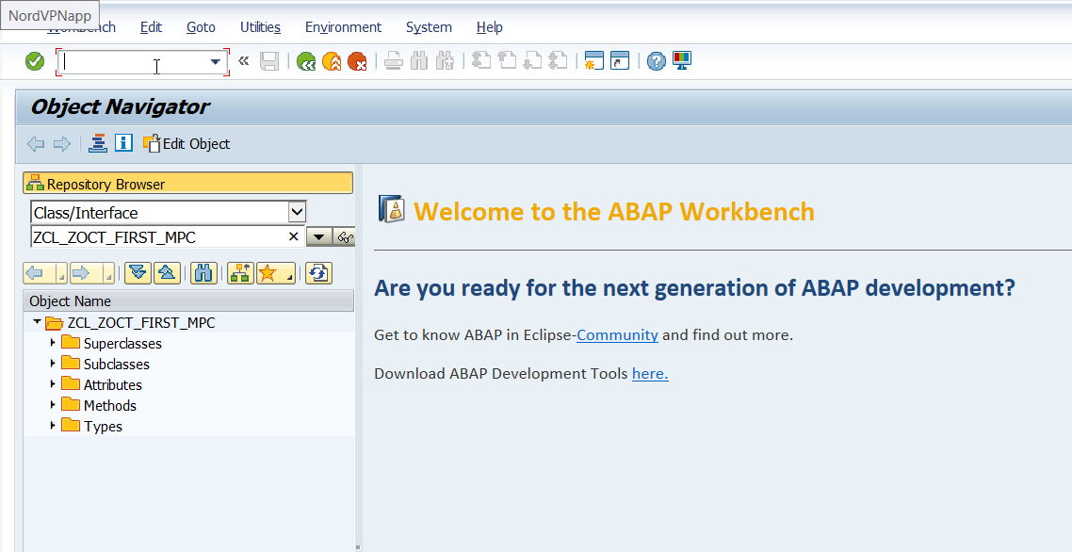
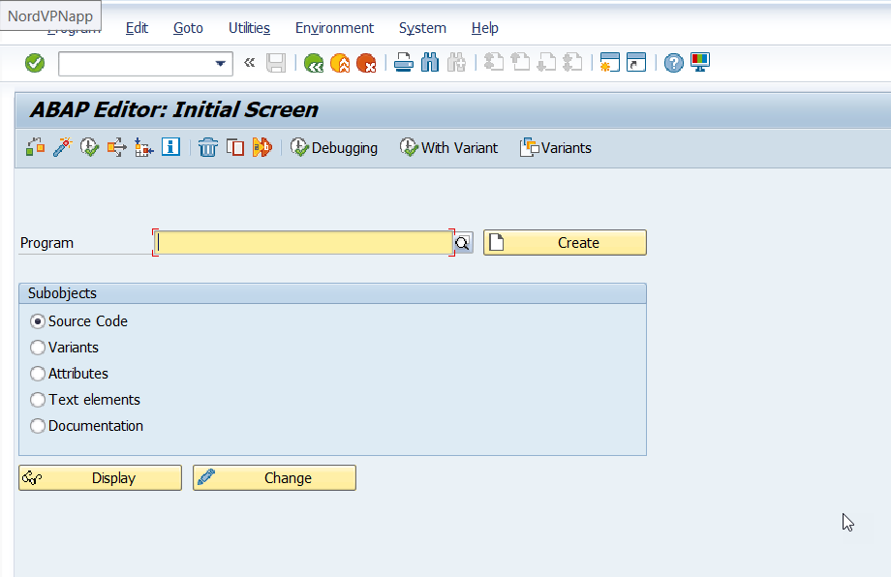
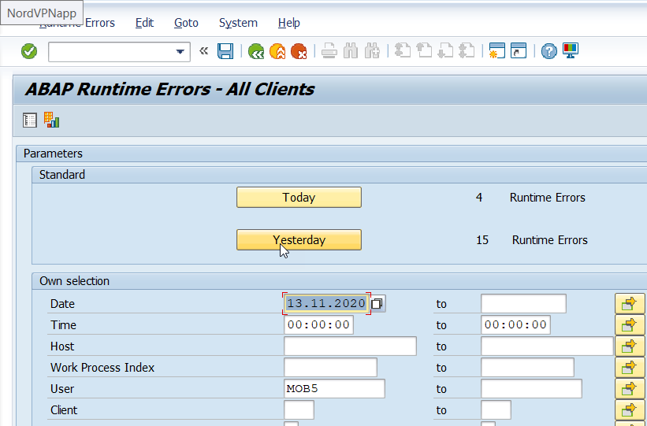
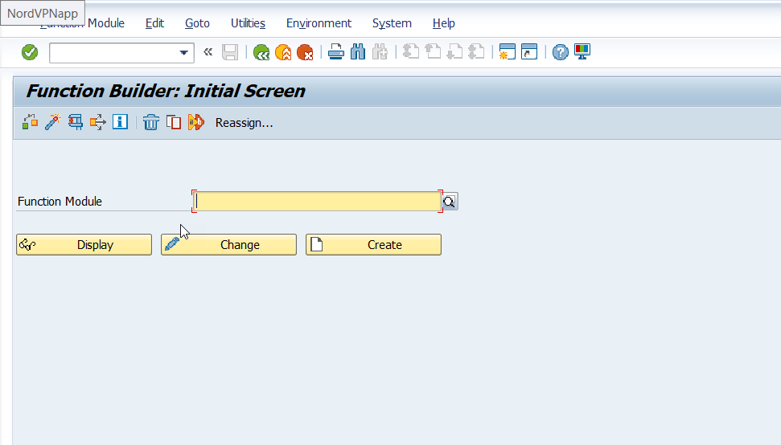
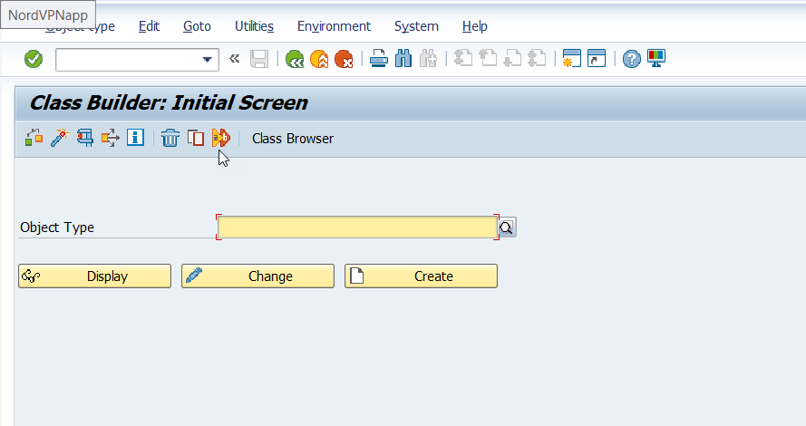
Exercise – Test TCodes

Slide 26
Exercise – Create Package and TR
Create your first development package before staring the development along with transport request.
Naming Convention: ZNC_PKG_XX
Trainer’s Participant Code - 00
XX – Participant Code 01-15
SAP delivers all their objects with any name they want but we want to develop in SAP system they don’t allow us any name.
Namespace – It must starts with Z or Y

Slide 27

Break

Slide 28
The Data Dictionary – SE11
Data dictionary is the remote control of database.
Data definitions (metadata) are created and managed in the ABAP Dictionary.
The ABAP Dictionary permits a central description of all the data used in the system without redundancies. New or modified information is automatically provided for all the system components. This ensures data integrity, data consistency and data security.
You can create the corresponding objects (tables or views) in the underlying relational database using these data definitions. The ABAP Dictionary therefore describes the logical structure of the objects used in application development and shows how they are mapped to the underlying relational database in tables or views.

Slide 29
What are all the objects in DDIC?
The most important object types in the ABAP Dictionary are tables, views, types, domains, search helps and lock objects.
Tables are defined in the ABAP Dictionary independently of the database. A table having the same structure is then created from this table definition in the underlying database.
Views are logical views on more than one table. The structure of the view is defined in the ABAP Dictionary. A view on the database can then be created from this structure.
Types are used in ABAP programs. The structure of a type can be defined globally in ABAP programs. Changes to a type automatically take effect in all the programs using the type.
Lock objects are used to synchronize access to the same data by more than one user. Different fields having the same technical type can be combined in domains.
A domain defines the value range of all table fields and structure components that refer to this domain. The ABAP Dictionary also contains the information displayed with the F1 and F4 help for a field in an input template.
The documentation about the field is created for a data element that describes the meaning of the contents of a table field.

Slide 30
A Database Table
A Database table is a collection of rows and columns used to store data. Example could be :
employee, company codes, sales data etc.
A table definition in the ABAP Dictionary contains the following components:
•Table fields define the field names and data types of the fields contained in the table
•Foreign keys define the relationships between the table and other tables.
•Technical settings control how the table should be created in the database.
•Indexes: To speed up data selection, secondary indexes can be created for the table

Slide 31
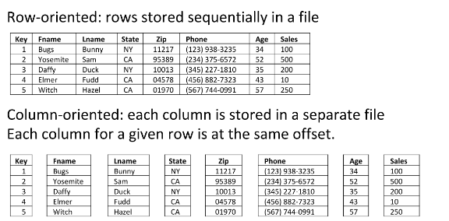
Row Store v/s Column Store in HANA DB

Slide 32
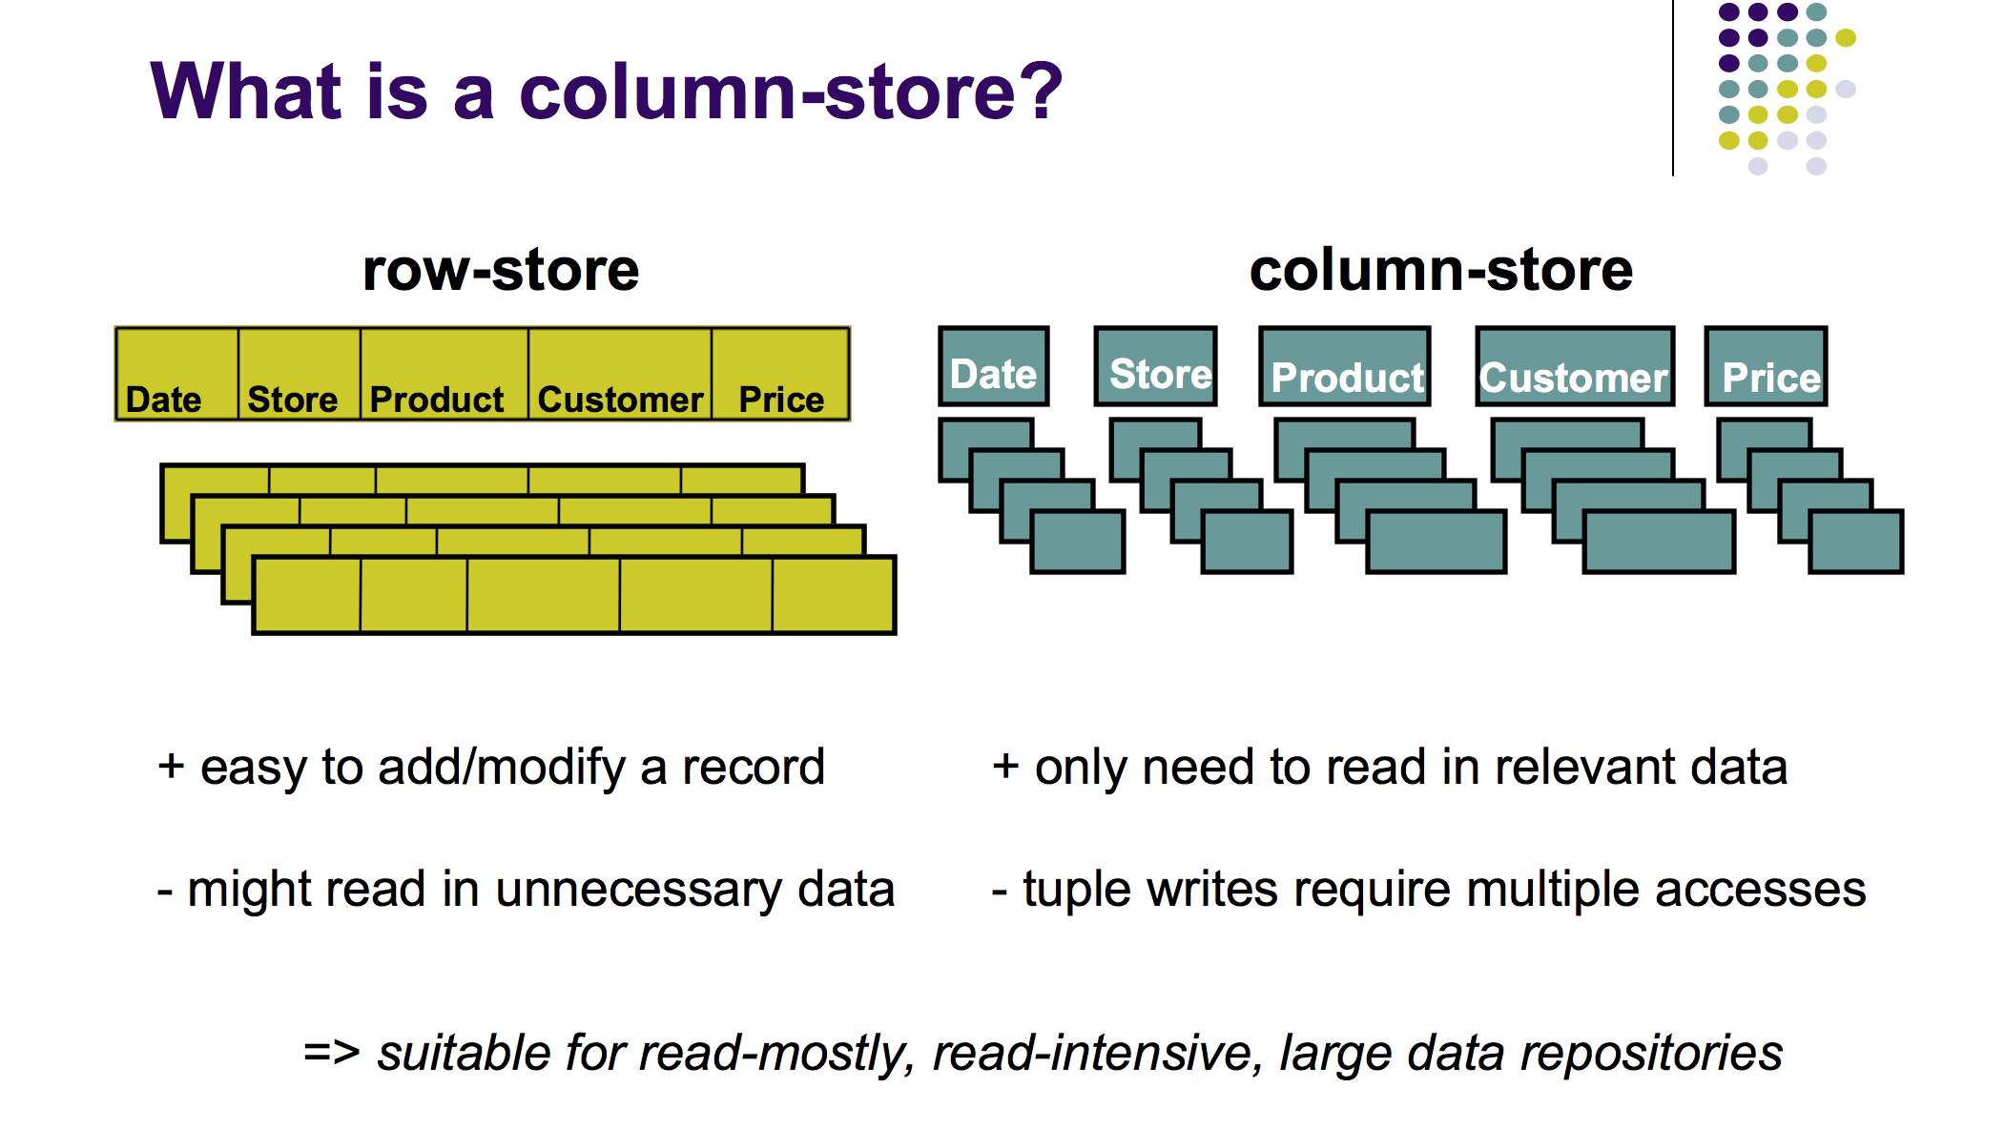
How to decide?
Row Store
Column Store
If there a table which is read less frequently and updated very often
Data Volume is low
If you always use SELECT *
Contains large no. of unique values
Typically selection of Row store is more restricted
If there a table which is read often – majority of ERP operation 70% READ
Data Volume is high
If you really not need all columns in your prog
Contains large no. of non-unique values
Default for all tables in ABAP on HANA Suitable for Master, Transaction table

Slide 33
Table Field/Column/Attribute
You must define the following for a table field in the ABAP Dictionary:
•Field name: The field name can have a maximum of 16 places and may contain letters, digits and underscores. The field name must begin with a letter.
•Key flag: determines whether the field should belong to the table key.
•Field type: data type of the field in the ABAP Dictionary (Direct or Data Element).
•Field length: number of valid places in the field.
•Decimal places: number of places after the decimal point, specifying numeric data
types.
•Short text: short text describing the meaning of the field.
Important Existing Data Types
CHAR: Character string. CLNT: Client. CUKY: Currency key. CURR: Currency field.
DATS: Date. DEC: Counter or amount field. FLTP: Floating point number. INT1: 1-byte
integer between 0 and 255. INT2: 2-byte integer between -32767 and 32767.
INT4: 4-byte integer between -2147483647 bis 2147483647.
STRING: Character string with variable length.
LANG: Language key. NUMC: Long character field in which only numbers can be entered.
QUAN: Quantity. Equivalent to an amount field DEC.
TIMS: Time.
UNIT: Unit.
FIELD1 | FIELD2 | … | FIELDN

Slide 34
Exercise – Create First Table
Create an Employee Table to store Employee’s Data. The structure of table looks like below.
Naming Convention: ZNC_EMP_XX
FIELD NAME | TYPE
EMPID | INT1
EMPNAME | CHAR256
SALARY | INT4
CURRENCY | CHAR10
DEPTID | INT1
AGE | INT4
GENDER | CHAR1

Slide 35
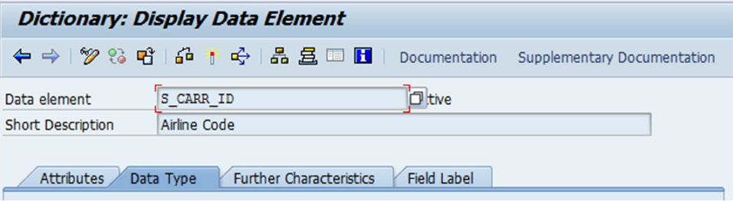
Data Element
Data element contain the semantic information (meaning) of a field. It will also help to maintain documentation about the field which will be from end users perspective. The text appearing in the field help (F1 help) in a field of an input template comes from the corresponding data element.
To create data element, we need to provide following details :
Data Type : Domain / Predefined type
Further Characteristics : (optional) Search help, Parameter Id etc.
Field Label : Label for data element w.r.t. fields and headings

Slide 36
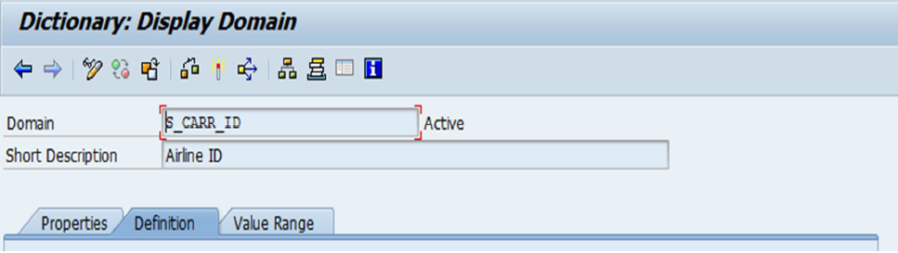
Domain
Data element contains the technical information(data type) of a field. A domain defines a value range. A domain is assigned to a data element. All table fields or structure components that use this data element then have the value range defined by the domain.
The relationship between the field or component and the domain is thus defined by the data element of the field or component.
Creating a domain we specify following information:
Definition : Data type, format and output length
Value Range: Fixed values, value table (possible set of values for the field)

Slide 37
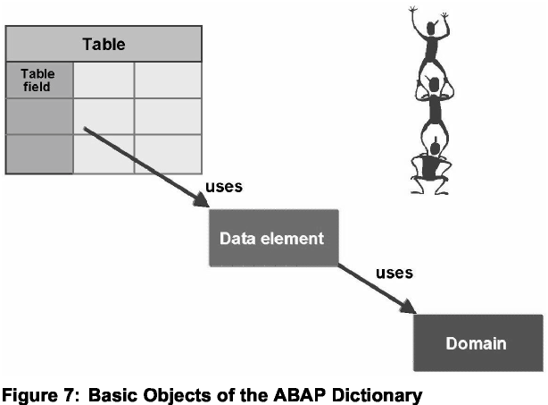
How are they Connected?

Slide 38
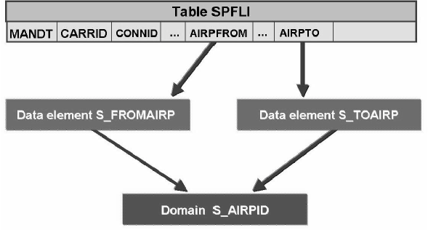
Best Practice

Slide 39
Exercise – Create Data Elements and Domains
Enhance the table by adding Data Elements and Domains for our table.
Maintain Salary and Currency Column with fixed values for currency as – USD, EUR, CAD

Slide 40
Table Technical Settings

Slide 41
Buffering

Slide 42
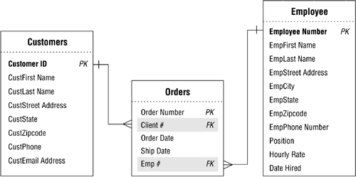
Foreign Key
A foreign key is a relationship between two table so that duplicate data can be removed from database. Table T1 is called the foreign key table (dependent table) and table T2 the check table (referenced table). The pair of fields for the two tables must have the same data type and length. One field of the foreign key table therefore corresponds to each key
field of the check table. This field is called the foreign key field.
Check table
Check table
Foreign key table

Slide 43
Exercise – Create Foreign Keys
Create one more database table called Department (ZNC_DEPT_XX) and maintain foreign key relationship.
ZNC_DEPT_XX
ZNC_EMP_XX
FIELD NAME | TYPE
EMPID | INT1
EMPNAME | CHAR256
SALARY | INT4
CURRENCY | CHAR10
DEPTID | INT1
AGE | INT4
GENDER | CHAR1
FIELD NAME | TYPE
DEPT_NO | INT1
DEPT_NAME | CHAR256
HOD | CHAR256
TYPE_CODE | CHAR10
EMPCOUNT | INT4

Slide 44
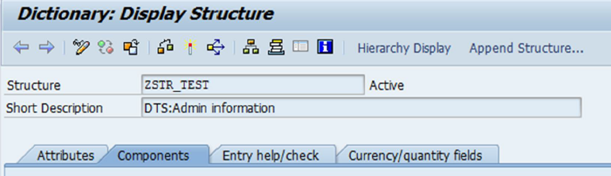
Structures
A structure is a series of fields grouped together under a common name. It is very similar to a table.
The differences between a structure and a table are as follows:
• A structure doesn't have a primary key.
• A structure doesn't have technical attributes.
• Structures follow the same naming conventions as transparent tables, and you cannot have a table and structure of the same name.
• The Delivery Class and Table Maint. Allowed fields do not appear.
• Structures will not hold data but variables created with reference to structure holds exactly one row.

Slide 45
Exercise - Structure
Create an Address Structure (ZNC_XX_ADDR) and include the same in Employee table for office and home address. Reuse the data elements provided
FIELDNAME | Data Type
HOUSE_NO | ZDTE_XX_HOUSENO
STREET | ZDTE_XX_STREET
CITY | ZDTE_XX_CITY
COUNTRY | LAND1
POBOX | ZDTE_XX_POBOX

Slide 46
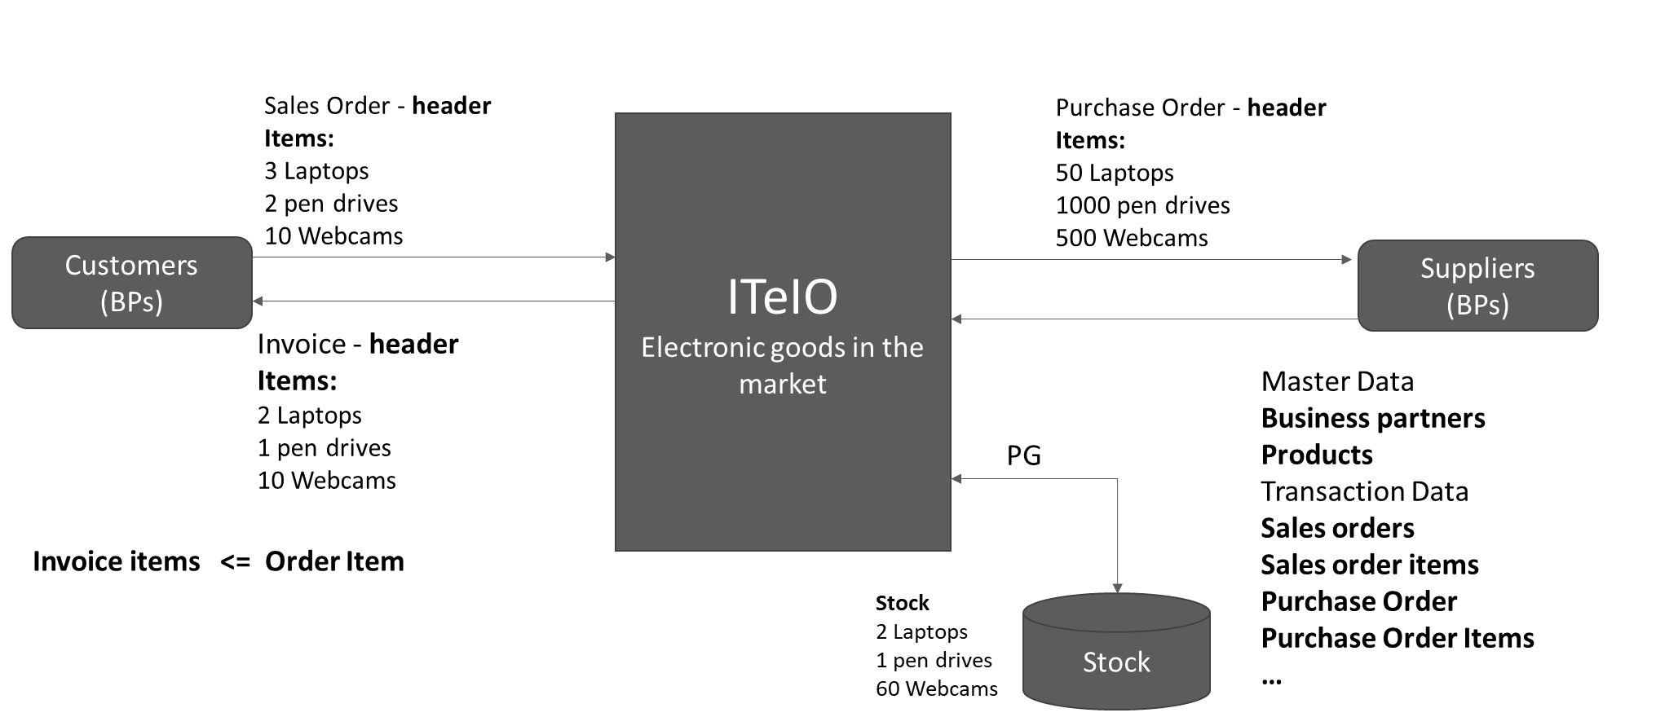
EPM Data Model
The EPM is a demo application which integrates many SAP NetWeaver technologies that are used by SAP S/4HANA applications. It is based on a common business process model and follows the business object (BO) paradigm to support a well-defined business logic

Slide 47
Exercise – Explore the EPM Tables
Find out common EPM Tables for
Business Partners – SNWD_BPA
Addresses - SNWD_AD
Product - SNWD_PD
Product Texts - SNWD_TEXTS
Orders - SNWD_SO
Order Items - SNWD_SO_I

Slide 48
Feedback
Students can access the forms directly from the student portal at:
https://www.netcomlearning.com/portal/student

Slide 49
End of Day 1

Slide 50

Questions

Slide 51

Anubhav Oberoy

